Slide 1

Wet Dry Windy and Flammable
Is Climate Change Correlated With Extreme Weather?
Joe Sellner, John Gotz, Guy Nasser Bssoume, Saradha Ramasamy

Slide 2
Questions
We often hear that climate change is related to an increase in extreme weather. Would amateur data scientists using publicly available data arrive at the same conclusion?
Which extreme events might show a correlation with increased temperature?
Can we predict the number of extreme events for the coming year?

Slide 3
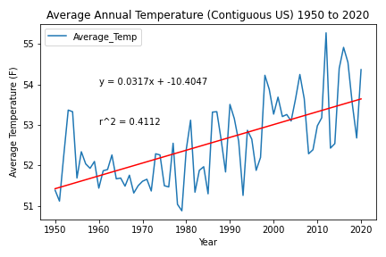
Temperature Data and Regression
The predicted average temperature for 2022 is 53.71 degrees Fahrenheit
Data Source: NOAA CONUS Annual Average Temperature

Slide 4

Hurricanes and Climate Change
Imported csv files that were downloaded from NOAA website
Used pandas to clean dataframe and filter out information
Grouped the data by year to store amount of hurricanes recorded per year
Created plots
Notes:
NOAA stands for National Oceanic and Atmospheric Administration

Slide 5
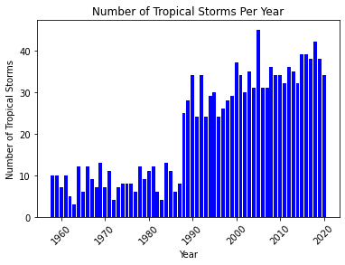
Hurricanes and Climate Change

Slide 6
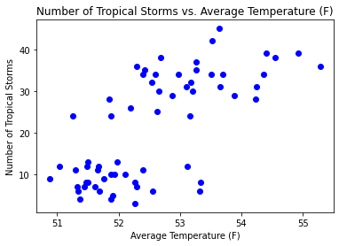
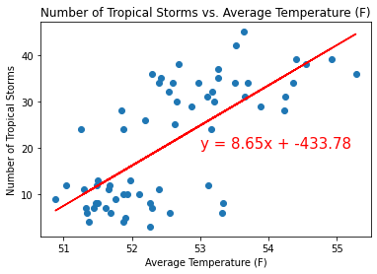
Hurricanes and Climate Change

Slide 7
Hurricanes and Climate Change
Hurricanes and Average Annual Temperature have a moderately positive correlation (R-squared = .49)
Using our predicted temperature of 53.71 (F) for 2022, the predicted number of hurricanes will be approximately 31

Slide 8
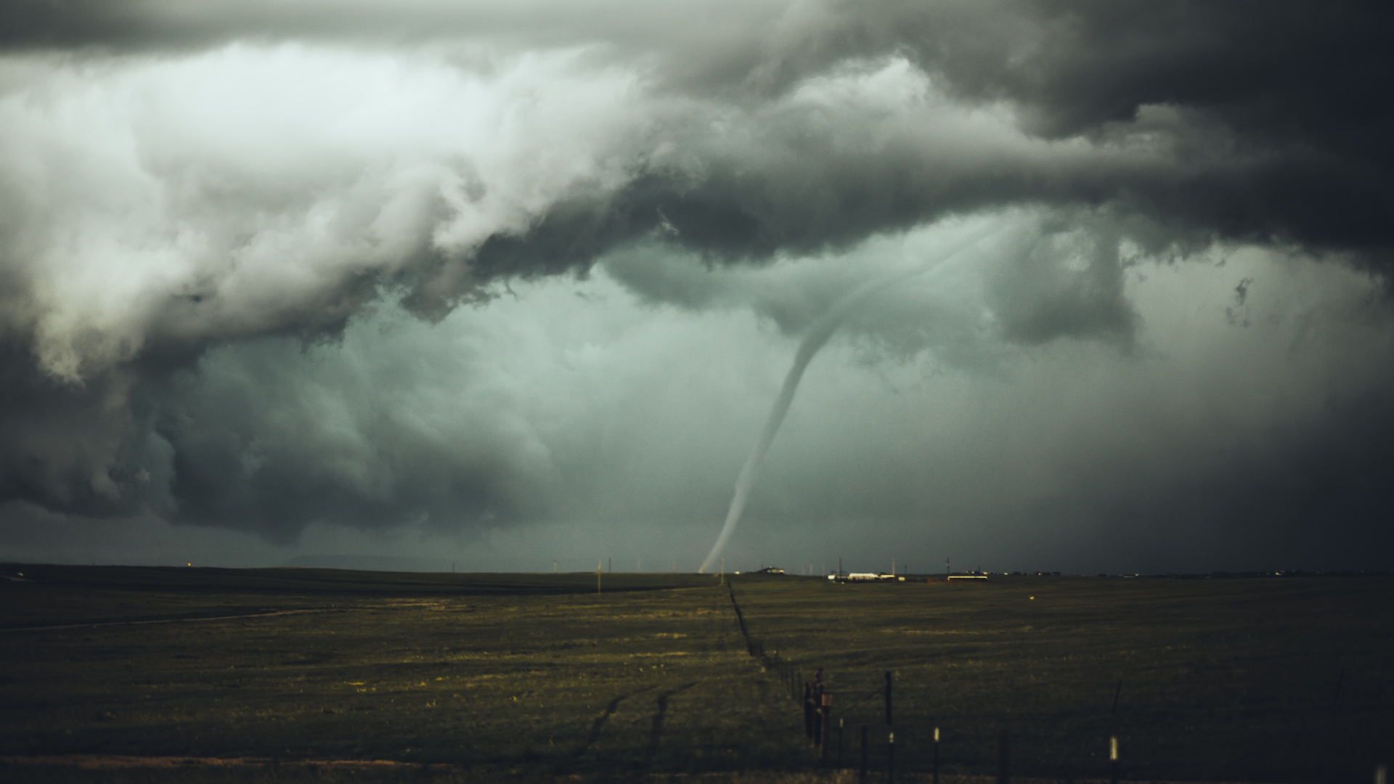
Tornadoes and Climate Change
Data Exploration and Cleanup
Data Source: NOAA Storm Events Database
Large source files with extraneous information
Used Pandas to condense and save cleaned csv files
Initial analysis - only severe tornadoes (F3/EF3+)
Very weak correlation
Correlation strengthened when ALL tornado events included

Slide 9
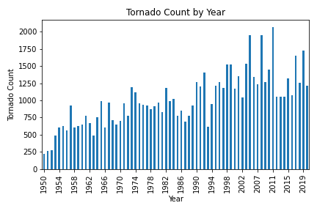
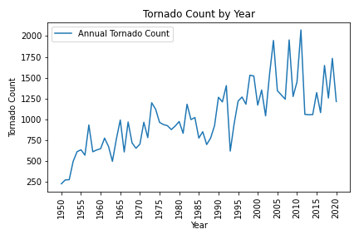
Annual Tornado Count 1950 - 2020

Slide 10
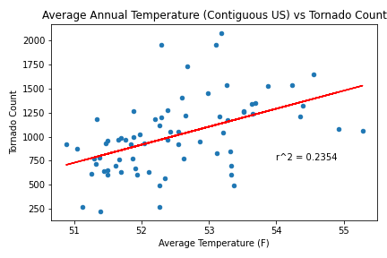
Tornadoes vs Temperature and Linear Regression

Slide 11
Tornadoes - Conclusions and Prediction
Annual tornado count and average annual temperature have a weak to moderate positive correlation (R= 0.49, R-squared = 0.24)
We predict the number of tornado events in 2022 to be 1235

Slide 12
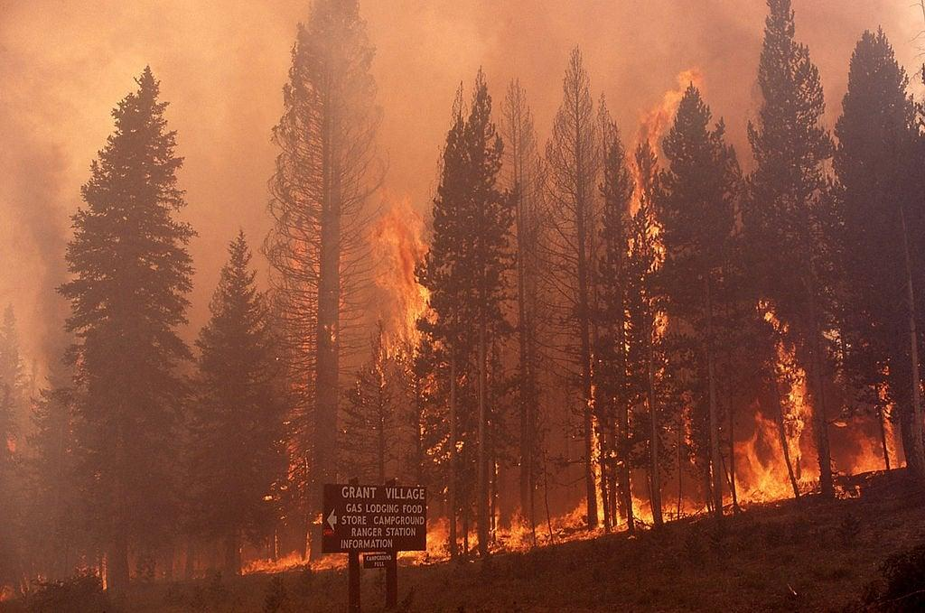
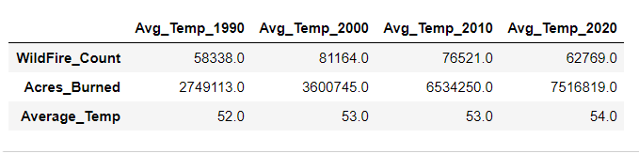
How climate change is causing wildfires?
Increasing temperature
Enhances the drying of organic matters in forest.
Drier conditions, drought are further spreading wildfire
Data source: https://www.nifc.gov

Slide 13
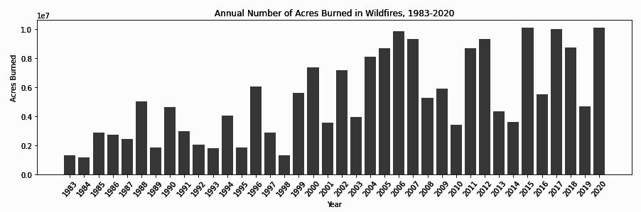
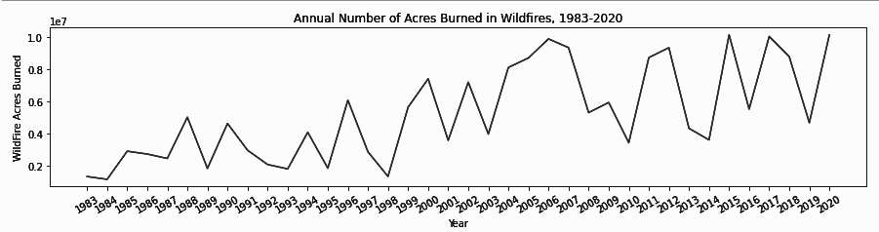
Wildfire Statistics
Largest fire count: 96,385
Year : 2006
Least fire count:18,229
Year : 1983
Average Wildfire count:
70,296
Largest acres burned:10,125,149
Least acres burned:1,148,409
Average acres burned:5,223,975

Slide 14
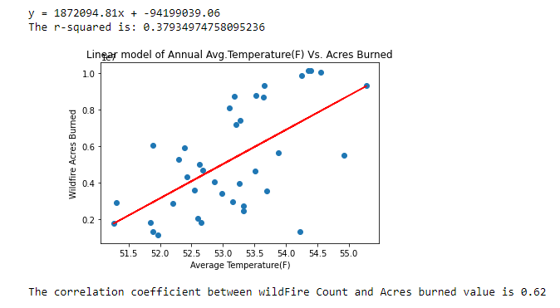
Wildfire - Linear Regression Model

Slide 15
Wildfire Conclusions and Prediction
Annual Acres burned and average annual temperature have a strong positive correlation.
Correlation coefficient is 0.62
We predict the Acres burned in 2022 will be 6,351,173.

Slide 16
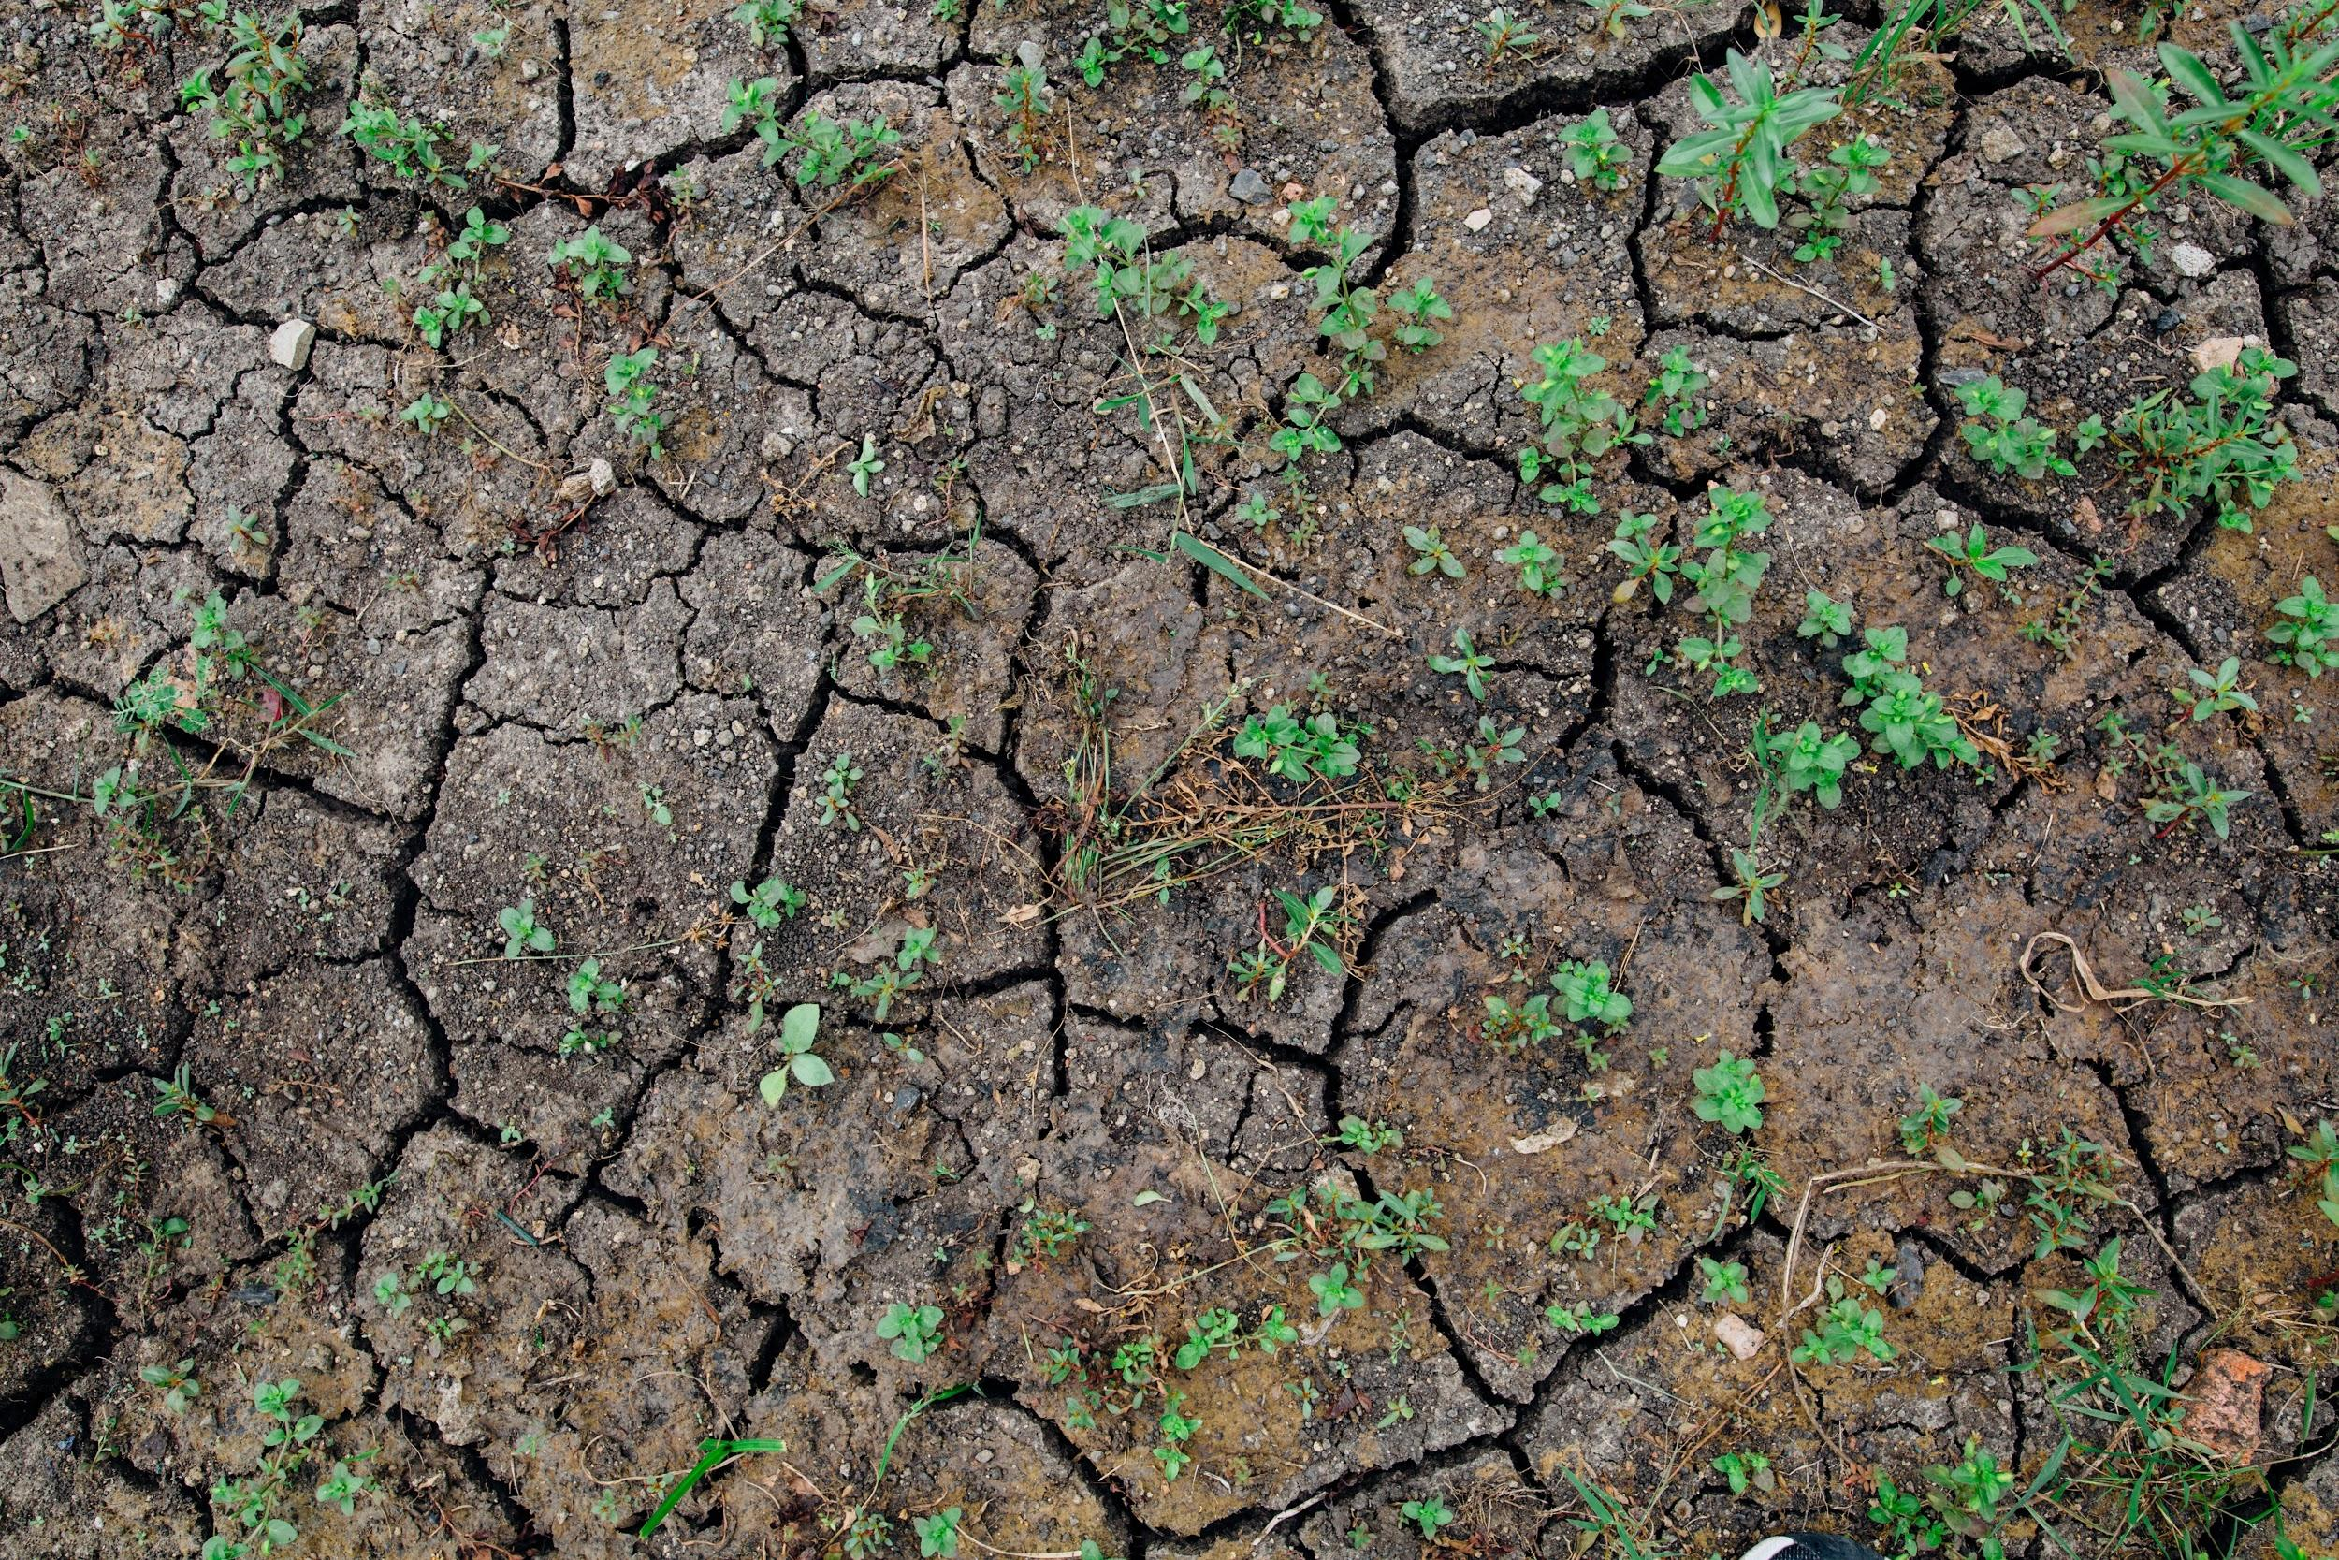
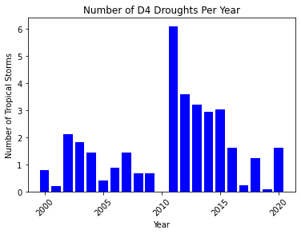
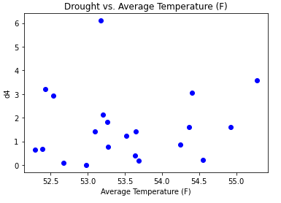
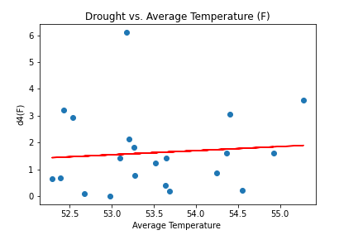
Droughts and Climate Change
Notes:
NOAA stands for National Oceanic and Atmospheric Administration

Slide 17
Droughts and Climate Change
Average percent of US in extreme drought and Average Annual Temperature have a weak positive correlation (R-squared = .007)
Using our predicted temperature of 53.71 (F) for 2022, the predicted percent of US experiencing extreme drought will be approximately 1.45%
This might have been more correlated with average temperature if we had data going back before 2000

Slide 18
Conclusions and Implications
Hurricanes, tornadoes, wildfires and drought are positively correlated with temperature
As temperatures continue to rise, so will the number of extreme weather events. This will have an economic, ecological, and social impact.
Analysis limitations
Extreme weather events tend to be seasonal
Extreme weather events tend to be concentrated in certain regions
Not all datasets had the same period of record available

